Slide 1

Permanent magnet demand
Permanent magnet production
- Permanent magnet motor forecast
Permanent magnet by usage trends
Supply chain
Critical raw material act and current situation
Short company presentation
ŽELEZNIKI, 2026
CONFIDENTIAL

Slide 2
Permanent magnet demand by sectors and regions

Slide 3
Rare earth magnet demand by sectors and regions

Slide 4
Rare earth magnet production in China and export
China exports of rare earth permanent magnets in 2025:
Quantity: 57392 t (-1,3% down from 2024)
Export to Europe was around 22.500 t
China export of rare earth in 2025:
Quantity: 62585 t (12.9% up from 2024)
Value 3.66 bilion RMB (5.1 % up from 2024)
There is distinction between total export volume and medium and heavy rare earth elements and magnet products, not the bulk light rare earths (lanthanum, cerium) that dominate tonnage statistics.

Slide 5
Rare earth magnet export from China by region
Europe volume of import permanent magnet was around 25000 T , 99% is from China
China exports of rare earth permanent magnets by region by volume in T

Slide 6
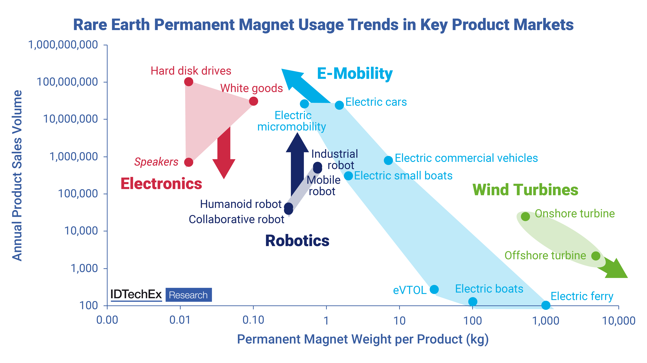
Permanent magnet by usage trends
With magnet usage in e-motors varying from several kilograms in cars to tens to hundreds of kilograms in commercial and larger vehicles, most new rare earth magnet demand by weight will arise from electric motor applications.

Slide 7
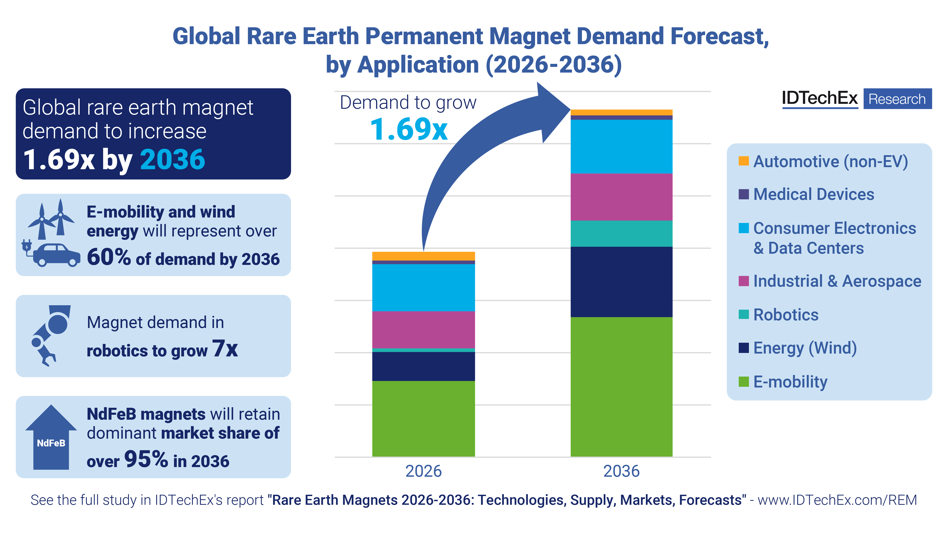
Rare earth magnet market

Slide 8
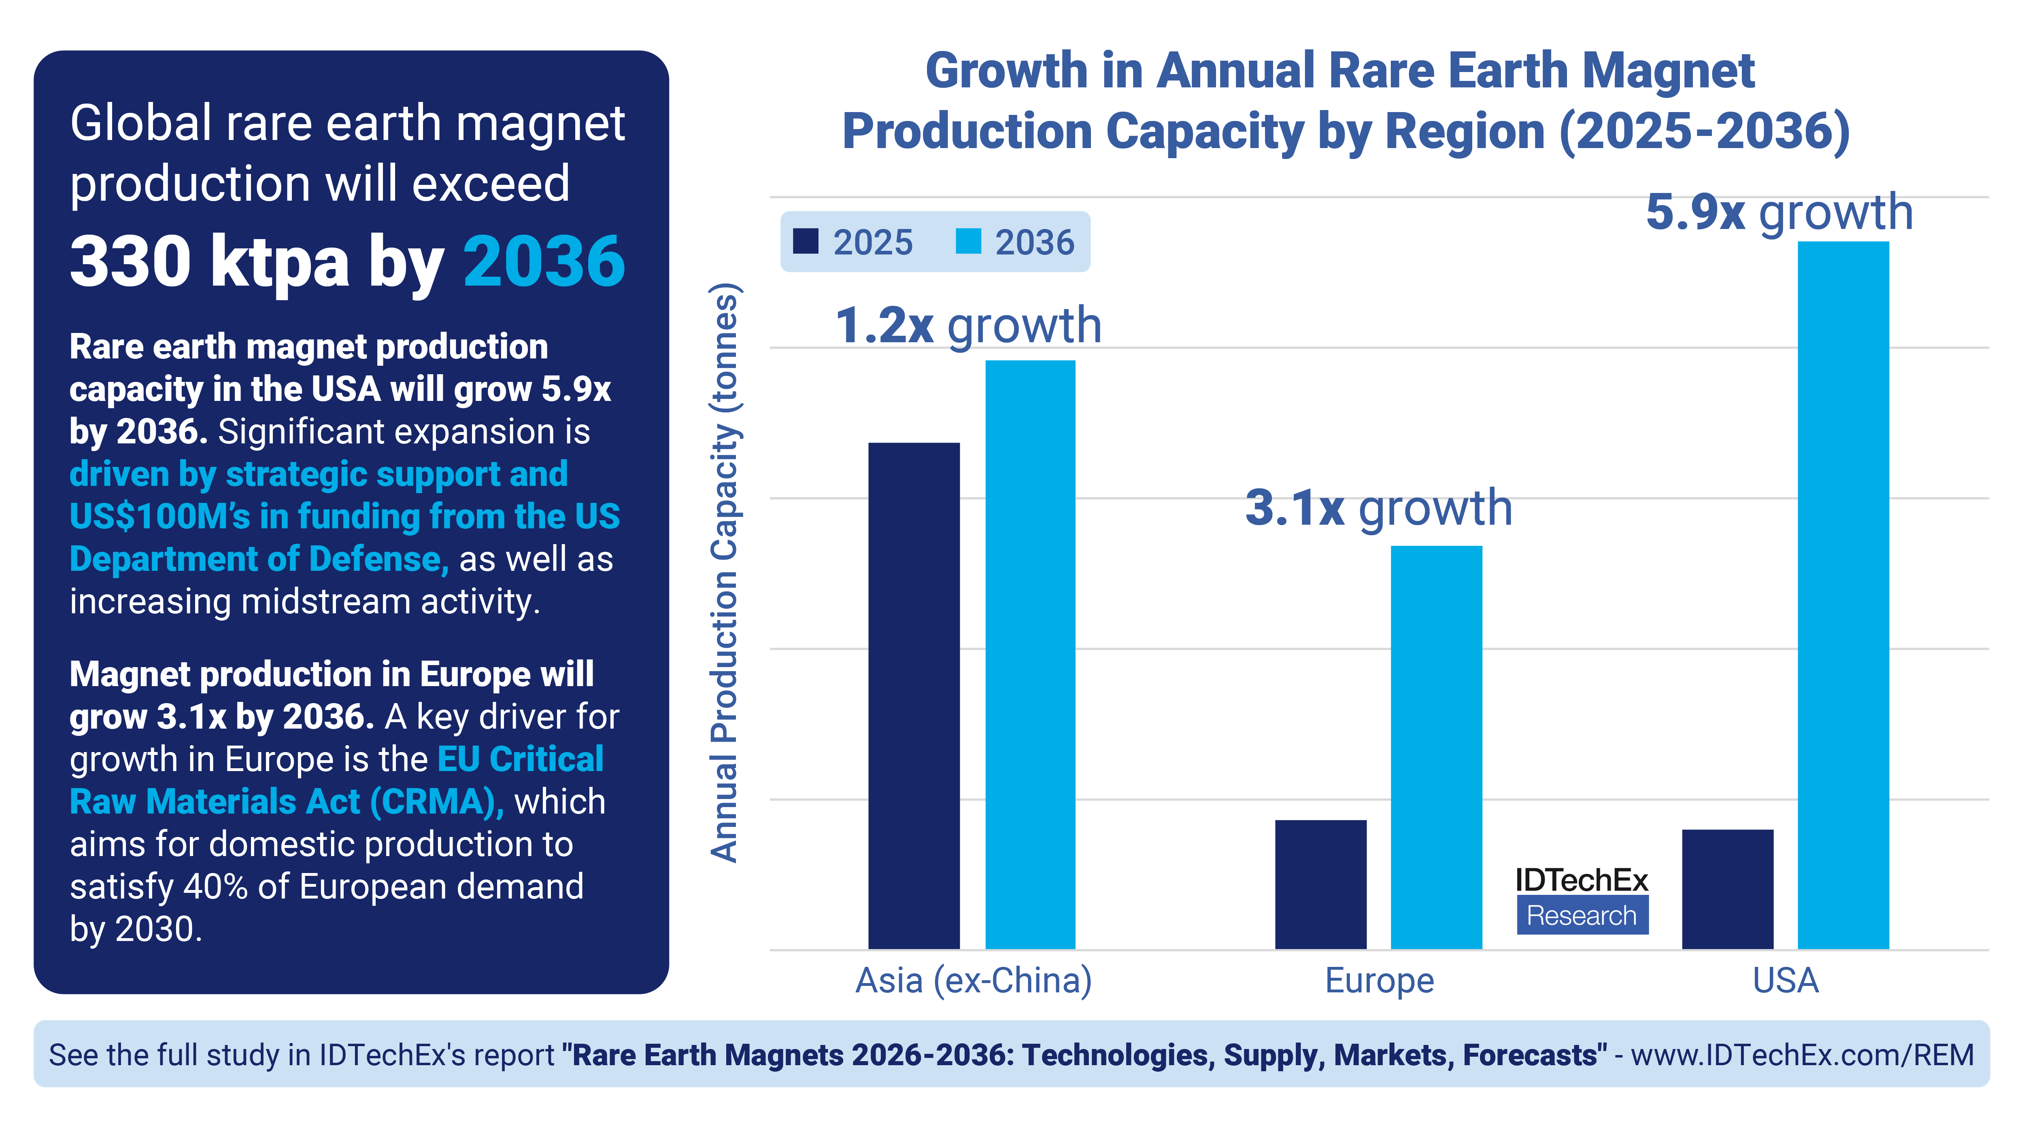
Rare earth magnet production growth by region
US administration’s pivot to rare earths makes sense or not , when it simultaneously degrades rare earth permanent magnet markets like electric vehicles and wind turbines. Both together are 60% of the entire rare earth permanent magnet market.
The capacities of NdFeB planned for the US are ca. 30,000 t/year, four to five times current US NdFeB imports.

Slide 9
Rare earth magnet alloys forecast

Slide 10
Rare earth oxide forecast

Slide 11
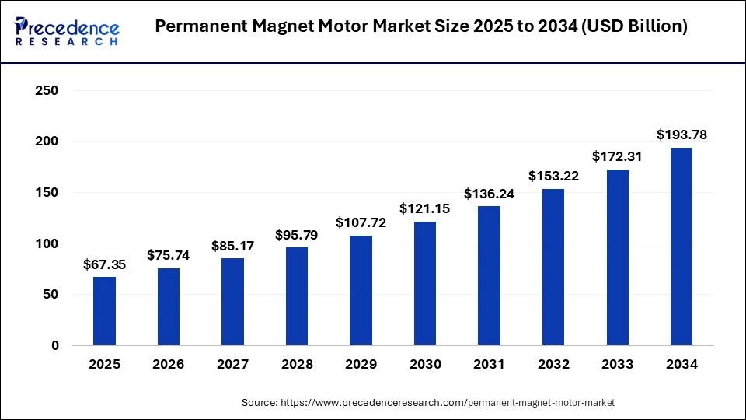
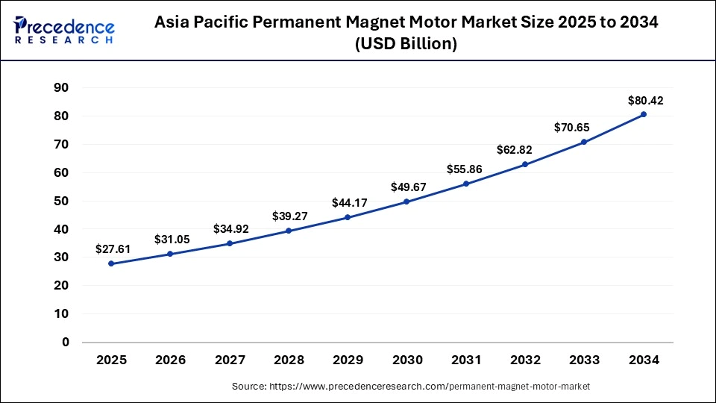
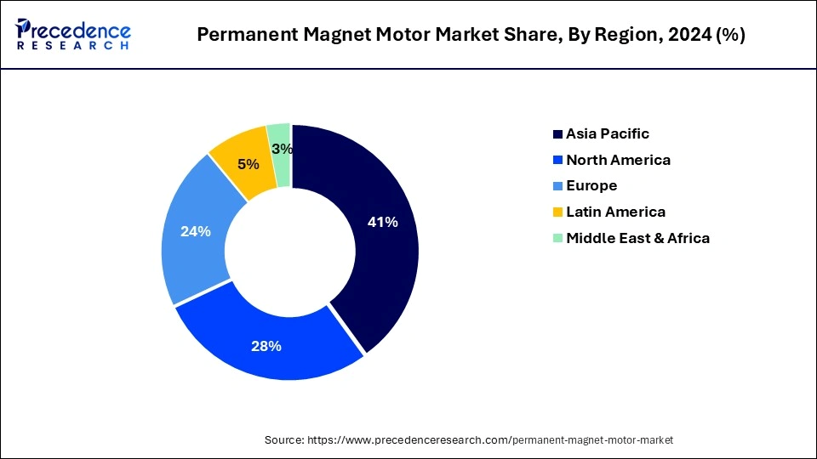
Permanent magnet motor market
The global permanent magnet motor market size was accounted at USD 67.35 billion in 2025 and is anticipated to reach around USD 193.78 billion by 2034 Germany is projected to grow at CAGR of 7.2% over the forecast period China will reach at US$ 16.2 billion by 2034 with a CAGR of 9.2% during the forecast period

Slide 12
Electric vehicle car sales by region
BloombergNEF estimates global new energy vehicle (NEV) sales grew 23% yoy in 2025, reaching 21.7 million. NEV sales, comprising battery-electric and plug-in hybrid EVs (PHEVs), are forecast to grow 12% in 2026 to 24.3 million. Over 2025, the EU saw very strong growth, surging 33% yoy to 3.9 million, with EVs reaching a record high 17.4% share in CY2025, up from 13.6% in CY2024. For the month of December 2025, EU EV sales exceeded ICE auto sales for the first time ever. NEV sales growth in China continued to outpace ICE vehicles, with China producing 34.4 million vehicles across all powertrains in 2025, up 9.4% from 2024.

Slide 13
Electric vehicle slow down, not due to China
China’s automotive industry has shown no indication of throttling this trend, with automakers setting ambitious sales targets for CY2026. Across the industry, average sales growth of nearly 20% yoy is projected.
March 2026 saw Honda of Japan announce it expected to make a net loss of ¥360-630bn in FY2025/26 and an overhaul of its electrification strategy, becoming the western auto industry’s latest casualty from a souring outlook for EV sales in the US and fierce competition from China. Stellantis and Ford have announced US$26bn and US$19.5bn writedowns respectively, after cancelling electric model launches and overhauling their global strategies. Failure to adapt to the speed and scale of China’s auto market leaders is proving a financially destructive outcome.

Slide 14
EV motors productions

Slide 15
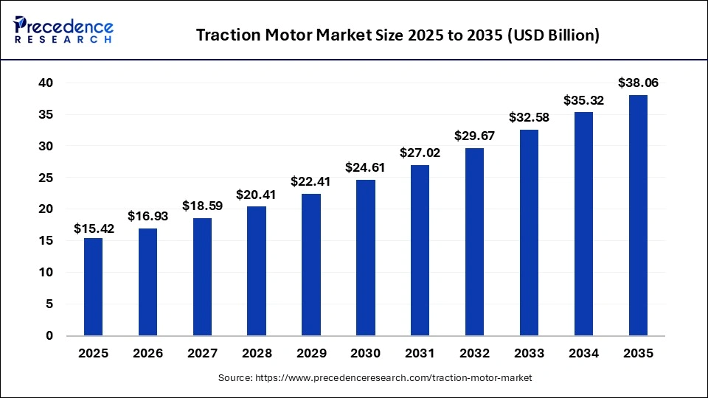
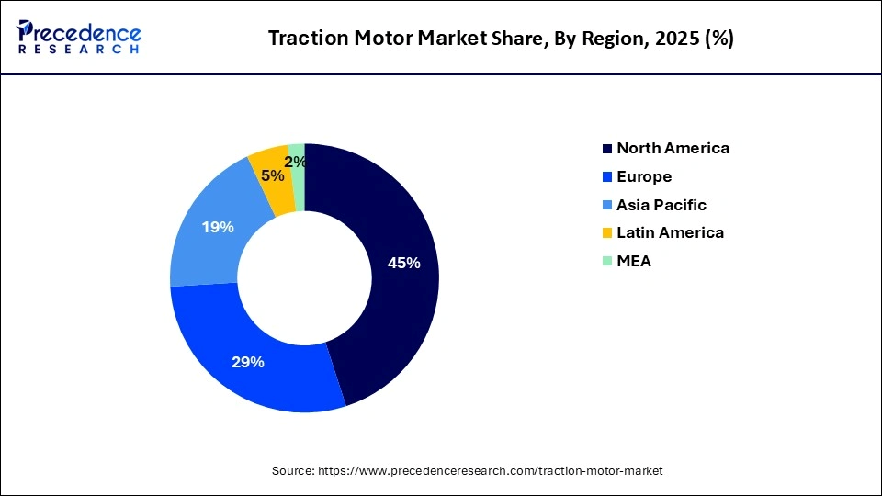
Traction motors market
The global traction motor market size is accounted at USD 15.42 billion in 2025 and predicted to increase from USD 16.93 billion in 2026 to approximately USD 38.06 billion by 2035, representing a CAGR of 9.46% from 2026 to 2035

Slide 16
Motors types

Slide 17
Global traction motor demand

Slide 18
European traction motors demands

Slide 19
Key motors trends
Rare Earth Reduction and Heavy Rare Earth Elimination
An iterative method to rare earth reduction is improving motor power density and efficiency through design optimisation. Higher speed motors for example can be smaller for the same power output (albeit with other trade offs),but will reduce overall material consumption. In general the market has moved towards higher power density and more integrated drive units as the market has scaled, but these reductions in rare earths are on the scale of tens of % rather than halving or more.
Other option in design is Hallbach Array motors (optimizing performance with fewer or weaker magnets)
Japanese automakers such as Toyota, Nissan, and Honda have all historically made announcements about reducing the heavy rare earth content of their motor magnets. This is largely through material engineering, such as refining the grain structure or tightly controlling impurities.
Since the heavy rare earths are primarily to prevent demagnetization at elevated temperatures, having a more effective thermal management system can also reduce the need for heavy rare earths. Manufacturers have increasingly adopted direct oil cooling for various parts of the motor, but the thermal system/design would have to be carefully considered, as demagnetisation of the rare earth magnets is not reversible.
Magnet Free Motor Designs
Another alternative that is already commercially viable is the externally excited synchronous motor (EESM). This has seen adoption from Renault, BMW, and Nissan in various EV models. This design uses copper electromagnets on the rotor, rather than rare earth permanent magnets. It does add some complexity in the need to power the rotor windings.
Other permanent magnet free designs such as synchronous reluctance, switched reluctance, and induction motors all have their own pros and cons, but will struggle to match the performance and efficiency of rare earth motors.

Slide 20
Car and motors

Slide 21
Wind capacity installations
New figures from the Global Wind Energy Council (GWEC) show 2025’s record new capacity installed was driven by accelerated growth across Asia. India set a new national record of 6.3 GW installed last year, while Europe deliver another 22.5 GW of new capacity - 5 GW more than was installed in 2024. In the United States more than 7 GW of new capacity, while China pass 100 GW, with 89 GW installed by the end of November. World pass 150 GW of wind energy installations in the year 2025.

Slide 22
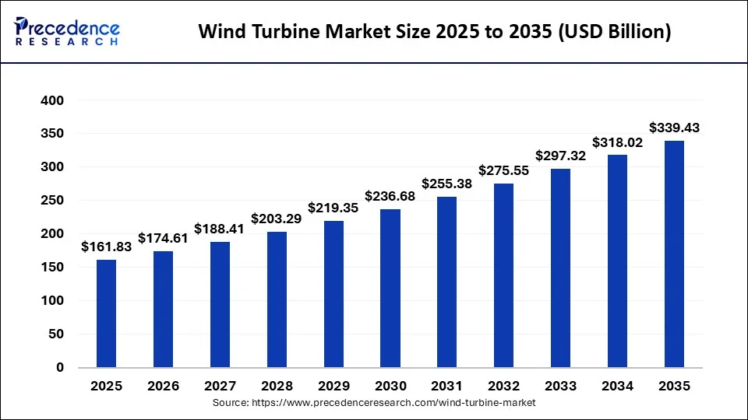
Wind turbine market
The wind turbine market is valued at $161.83 billion in 2025. The global wind turbine market is growing at a CAGR of 7.69% in the forecast period 2026 to 2035
Trump administration will pay $1 billion to a French company to walk away from two U.S. offshore wind leases.
TotalEnergies has agreed to what’s essentially a refund of its leases for projects off the coasts of North Carolina and New York, and will invest the money in fossil fuel projects instead.
In May 2025, China unveils world's largest offshore wind turbine with hub height of 185 meters. With a hub height of 185 meters – equivalent to a 63-story skyscraper – the single 26-megawatt (MW) turbine can potentially generate 100 million kilowatt hours (kWh) of renewable electricity each year.

Slide 23
Europe wind market and global players
If the EU meets its targets, wind is set to supply over a third of the bloc’s electricity needs by 2030 and half of its power demand by mid-century. Wind power and Europe’s wind industry are therefore central pillars of European energy security.
2024 was the first year on record that Western wind turbine makers did not rank in the top three wind turbine suppliers

Slide 24
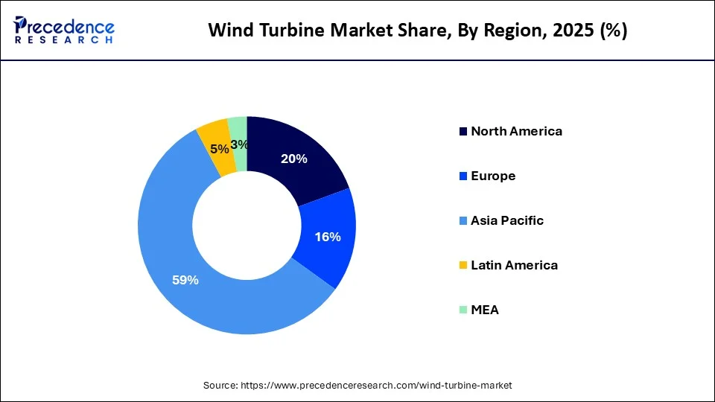
Wind turbine market by region
By 2030 growing wind capacity will see countries like Vietnam, Australia and the Philippines catching up with Europe’s mature markets. These markets see renewable energy as key to powering their GDP growth targets.

Slide 25
Wind turbine development
Synchronous permanent magnet generators (SPMG) are lower weight and smaller, attractive for larger wind turbine designs
•When used in a direct-drive system, the lack of gearbox reduces maintenance costs, further reduces weight and size and improves efficiency.
In May 2025, China unveils world's largest offshore wind turbine with hub height of 185 meters. With a hub height of 185 meters – equivalent to a 63-story skyscraper – the single 26-megawatt (MW) turbine can potentially generate 100 million kilowatt hours (kWh) of renewable electricity each year.

Slide 26
Robots

Slide 27
Industrial robot installations

Slide 28
Colabborative robot installation

Slide 29
Industrial robots installation by market

Slide 30
Germany robot installation

Slide 31
Industrial robot forecast

Slide 32
Service robots

Slide 33
Applications

Slide 34
Humanoid Robots
There is no massive use today but serial production in preparation
Manufacturers are building humanoid robots for R&D purposes for several years and producing on demand
New companies in the market do build humanoids at a demonstrator or prototype stadium for first trial applications
Application fields of humanoids still have to be determined and proven in practice

Slide 35
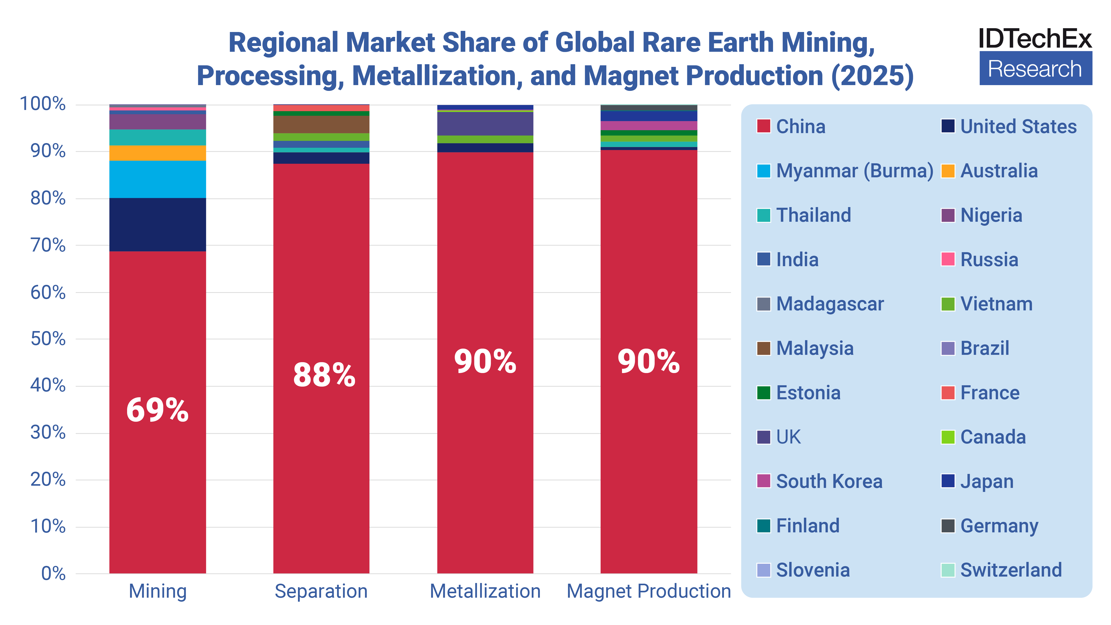
Supply chain market share

Slide 36
Non China supply chain

Slide 37
CRMA

Slide 38
CRMA current status

Slide 39
CRMA and mining
EU’s domestic demand for rare earth oxides used to produce magnets will approach 5,500 tonnes per annum by 2030, of which a modest 10% would have to be mined in the union, as per the CRMA.
The European Union is host to a growing number of prospective rare earth deposits and advanced development projects, including Kiruna (LKAB- could use tailings ) and Norra Kärr in Sweden , Kvanfjeld(Greenland – uranium ban in 2021), Finland (Sokli); Fen Norway and Spain. Norra Kärr in southern Sweden is rich in heavy REEs like ytterbium, terbium, and dysprosium. Since 2025, mining lease application application is underway- could be first European mine.
Overall, it is estimated that the time horizon for a mining project to become operational in the EU is typically between 10 and 15 years, but can be up to 20 years.

Slide 40
CRMA and processing
In 2025, Solvay restarted operations (small amount) ,there is 4,000 MT (not for magnets) La Rochelle plant in France
Carester with Solvay cooperation commenced construction of a 1,400 MTs commercial plant.
Neo Performance Materials (NPM) operates the pilot separation in Silmet plant in Estonia.
Reetec Norway (bougth by LKAB) – ion exchange, plan 720 MTs – commissioning
LCM – only metallization plant NdPr metal 6-cell operation in the UK, 330 MT per year, 60T DyFe, 25T Tb per year
JOGMEC and Iwatani Corporation have signed a contract with Carester to securea long-term supply of 50% of the heavy rare earths produced by the company. USAR acquire Less Common Metals (“LCM”) for $217 million.

Slide 41
CRMA and recycling
In 2023, nearly 21,000 tonnes of NdFeB magnets were discarded in Europe in end-of-life (“EOL”) devices.
Of this amount, less than 1% is currently recycled.
In recent years, several government-funded research projects in Europe have promoted the recycling of rare earths, involving domestic companies along the value chain.

Slide 42
Operational recycling in EU
Carester (Solvay) aims to recycle 2,000 MTs of magnets and refine 5,000 MTs of mining concentrates annually, establishing Europe’s first large-scale REE recycling facility and the largest Western producer of heavy REEs. The planned annual output, 600 tonnes of Dy-prosium and Terbium oxides accounts for around 15% of global production. (Caremag 2025). Caremag facility (a Carester subsidiary) is listed in the Commission’s annex as one of the Strategic Projects.
Solvay Q3 2025 report –CEO info: rare earths, just to avoid any misunderstanding, we are not saying that we will invest between €50 and €100 million today. This year was investing a few million to start the production of Nd/Pr. So for the light rare earth magnets. We will do the same for the heavies. It's just to show we know how to do it. Now, if you ask me today, do you have offtake contracts to move to the real projects? So regarding the big investment of €50 to €100 million? I would say not yet.
Magreesource since December 2024, it has operated a small pilot plant for REE recycling in the Isère department, with an annual capacity of 50 tonnes
Pump manufacturer Wilo & Heraeus Remloy Collaboration. Short-Loop Recycling from end-of-life pumps and production scrap. Using short-loop processes such as hydrogen decrepitation and re-sintering. Opened in 2024, 600MT per year.
HyproMag in England and Germany short loop- targeted 100MT to 350 MT per year each location min, by now over 3000 magnets produced and testing-Hydrogen Processing of Magnet Scrap was developed to retrieve environmentally friendly Nd-Fe-B powder environmentally

Slide 43
Recycling projects in EU

Slide 44
NdBeF magnet production in Europe
Neo Performance Materials (NPM) opened a 2,000-ton-per-year magnet plant in Narva, improving EU capacity . Plan for expansion 5000T. Silmet is still not a “Strategic Project” of the EU. (European Commission 2025) Hastings?
Vacuumschmelze in Germany (capacity 1000 MT data from 2022 ), eVAC in US – 1600 MT in 2025 (need 2000T alloy)
Magneti Ljubljana in Slovenia(NdFeB capacity last data 20 MT per year), base focus till now Alnico, SmCo
GKN lately infomed not to go further with sintered magnet production since is not profitable

Slide 45
RESourceEU
On 3 December 2025, the European Union adopted the RESourceEU Action Plan, which will mobilise up to 3 billion euros to support critical mineral raw materials for Europe1.
RESourceEU will initially focus on rare earth permanent magnets, battery raw materials and defence-related raw materials.
The RESourceEU plan contains a number of concrete actions:
-It will fast‑track projects and decisions by imposing tight deadlines (12 and 36 months) for permitting or other key administrative steps, mirroring the accelerated timelines the CRMA already sets for “strategic projects”.
RESourceEU also introduces demand-side measures, including the option of a price floor to boost non-Chinese supply
The EU will set up a new European Critical Raw Materials Centre, which will act as a key hub for critical minerals in the EU, handling investment, stockpiling, and joint purchasing. EU and member states will also start stockpiling critical minerals next year.
EU has taken action to restrict the export magnet raw materials from the bloc, which will secure feedstock for recycling companies in Europe, helping to produce a European supply of critical minerals.

Slide 46

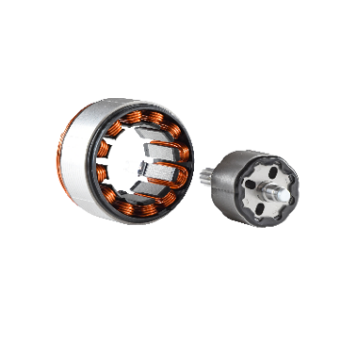
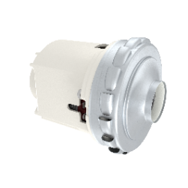
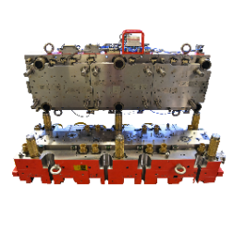
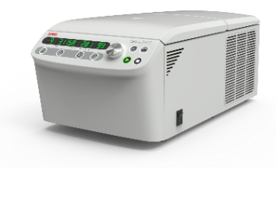
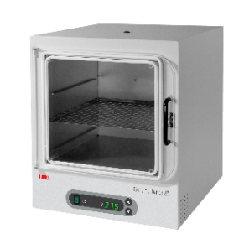
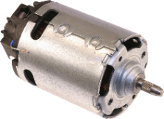

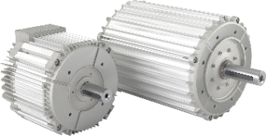
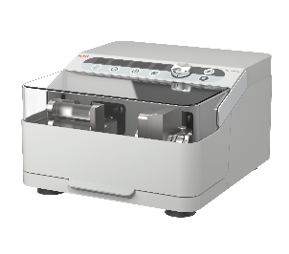
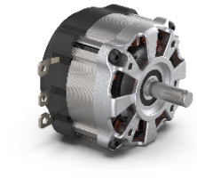
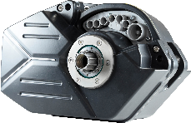
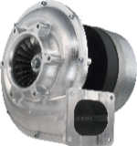
DOMEL PRODUCT PORTFOLIO
PROFESSIONAL AND HOME APPLIANCES
MOBILITY
INDUSTRIAL
MEDICAL AND LABORATORY
31%
15%
30%
23%
2%
> 50 % based on EC Technology

Slide 47
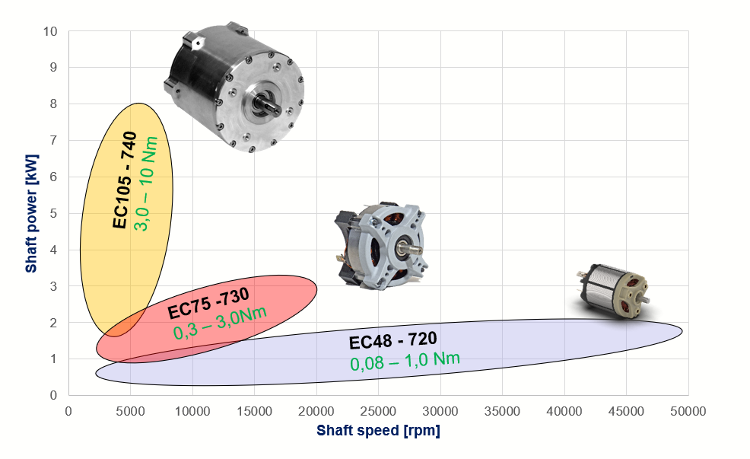
Domel EC Motor overview

Slide 48
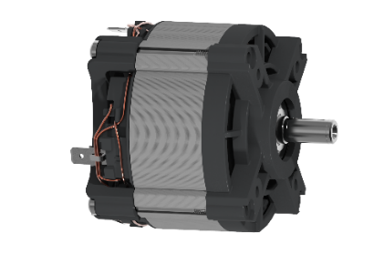
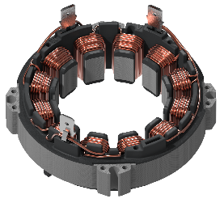
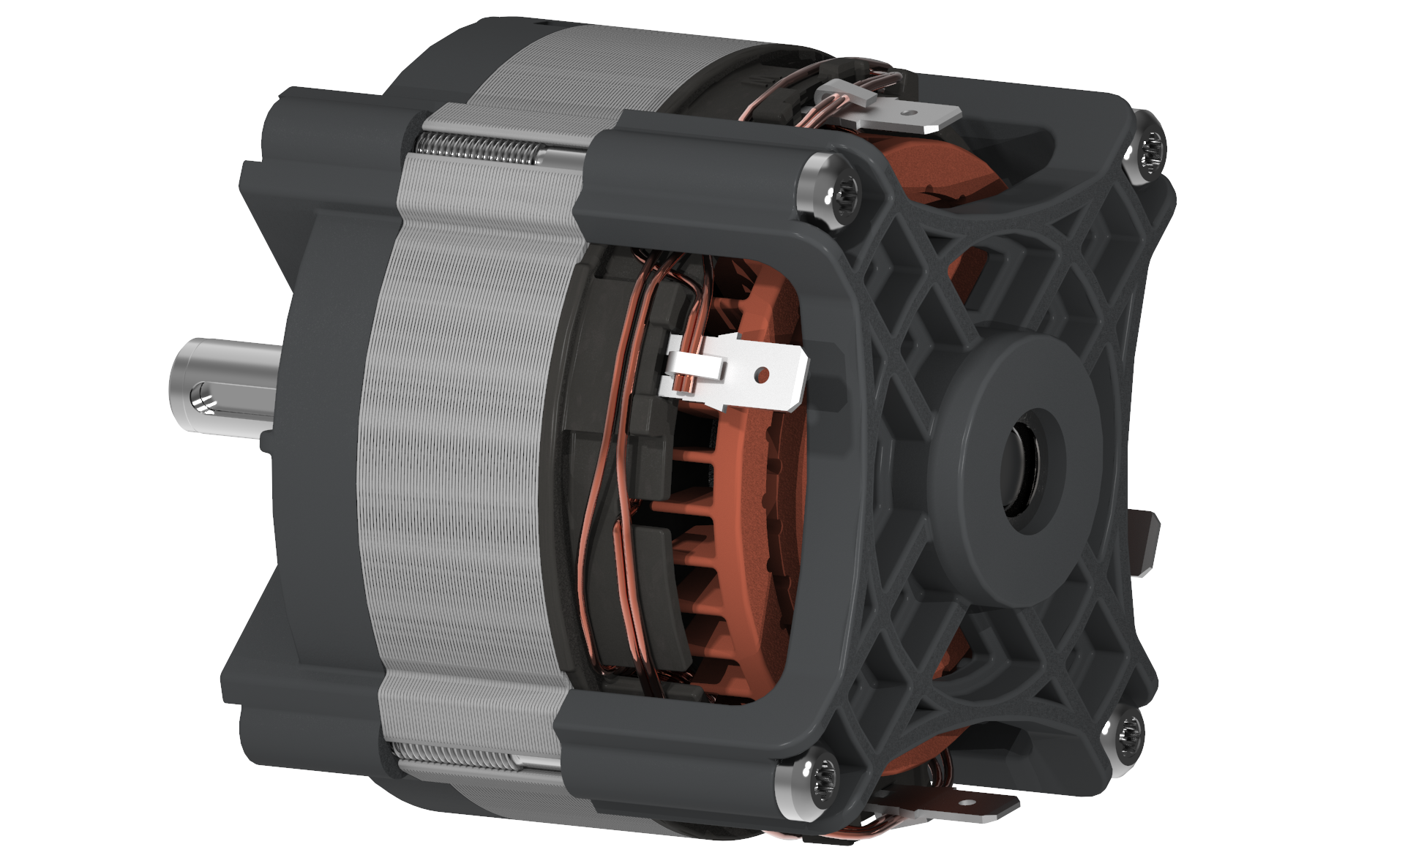
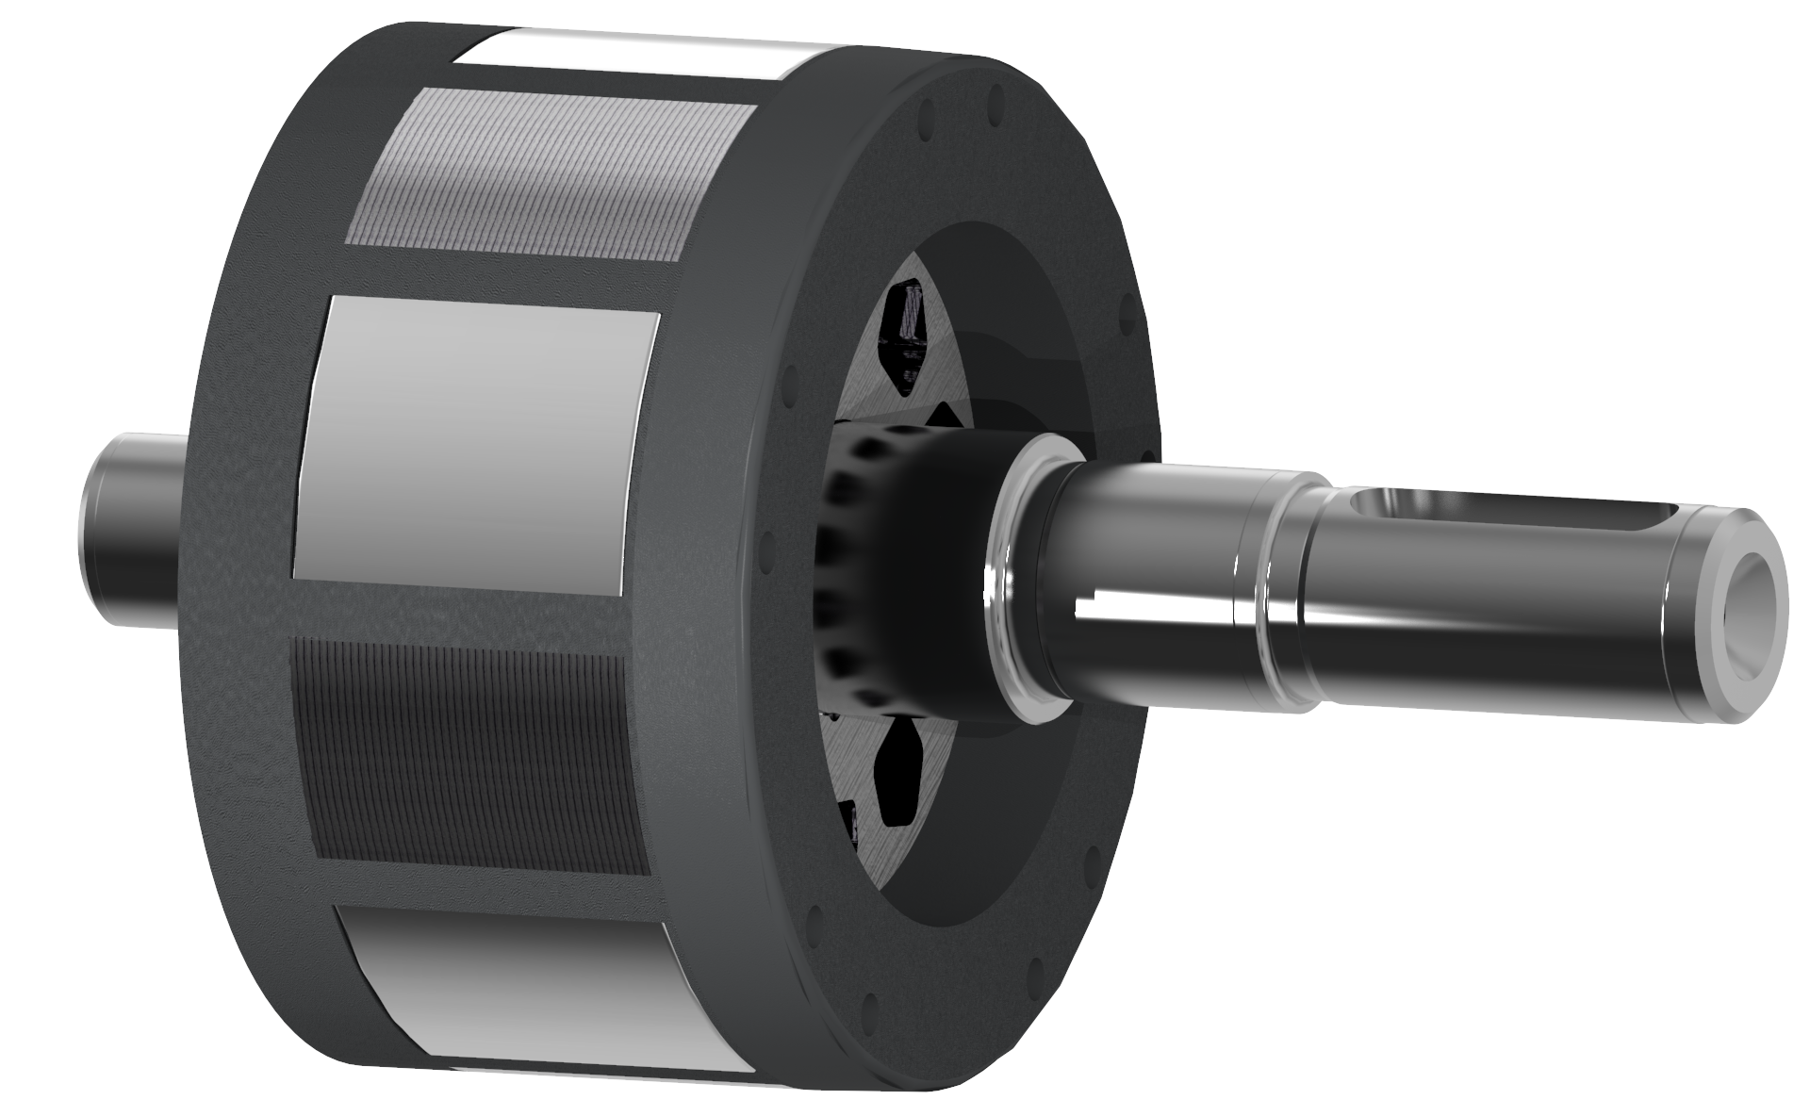
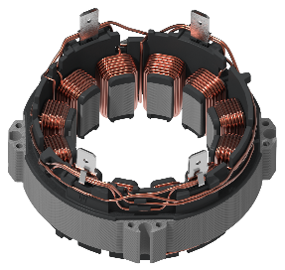
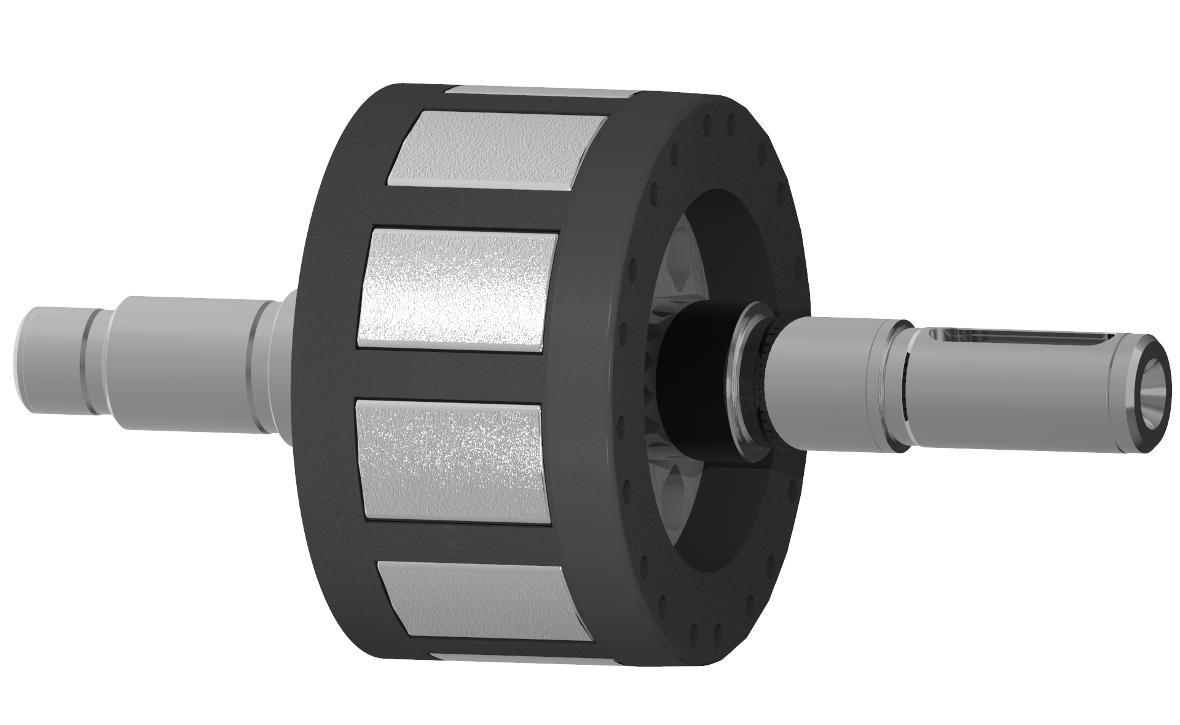
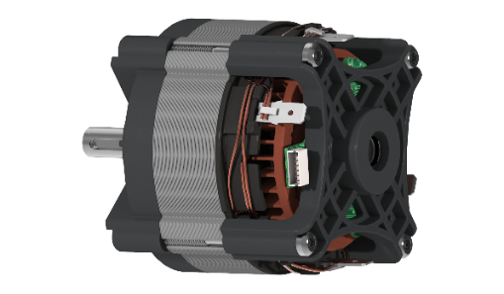
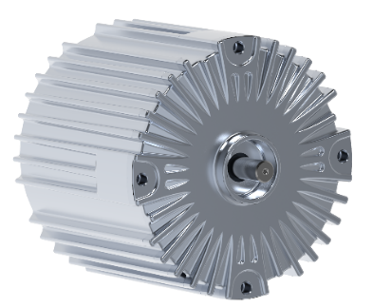
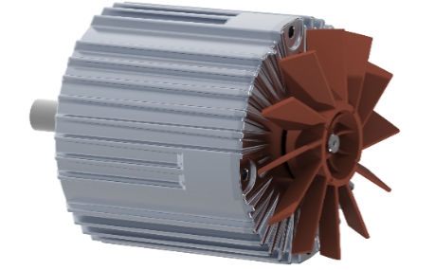
7x0 EC Motor variants
MODULAR DESIGN
Stator delta
Without fan
5 – magnet rotor
For medium torque,
cost optimized
With internal fan
10 – magnet rotor
For high torque,
high end
With internal fan and
Hall sensors
Stator delta parallel
Enclosed in a housing

Slide 49
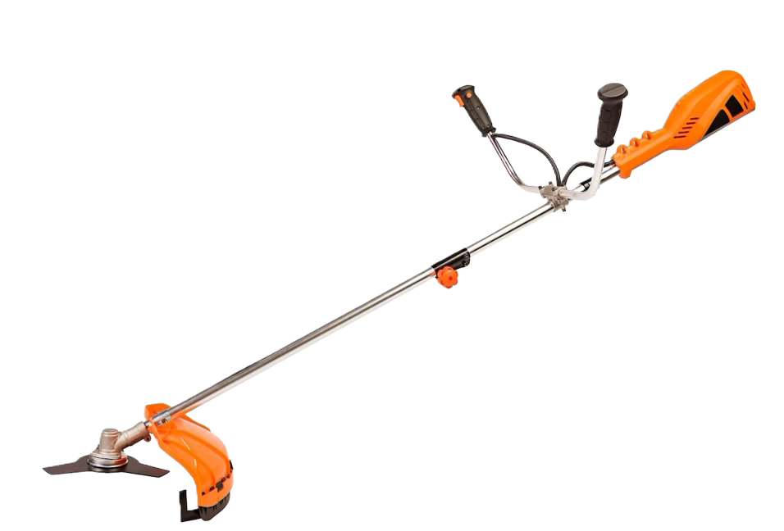
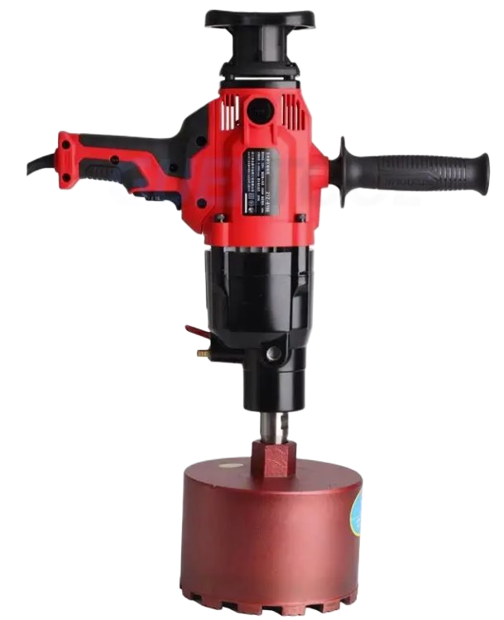
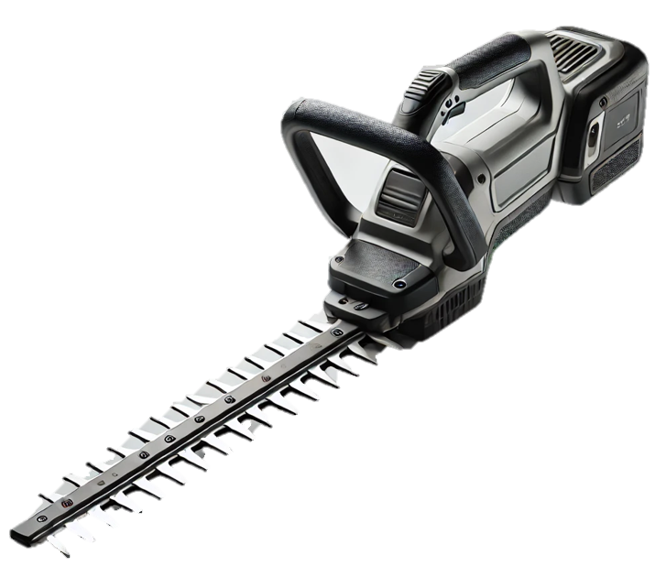
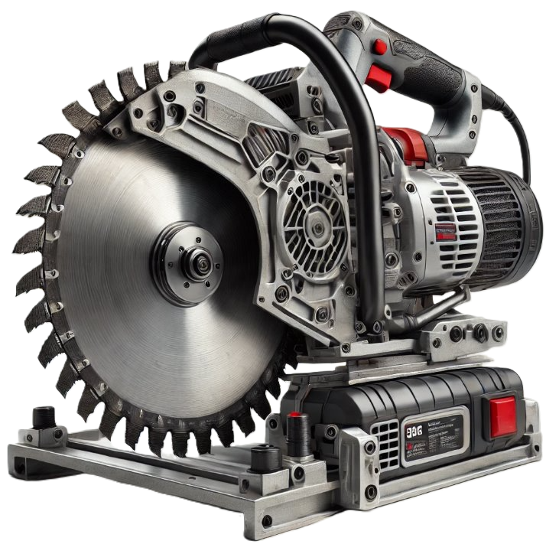

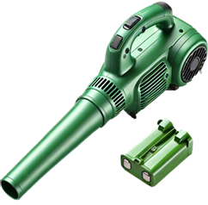
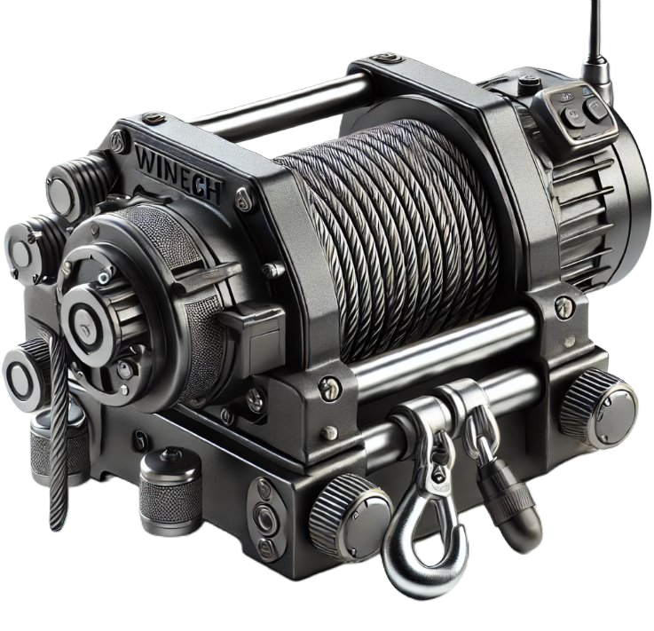
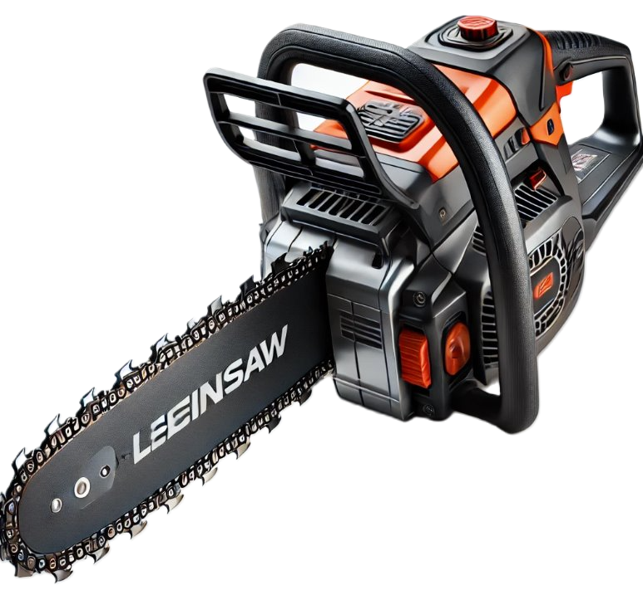
EC Motor Applications

Slide 50
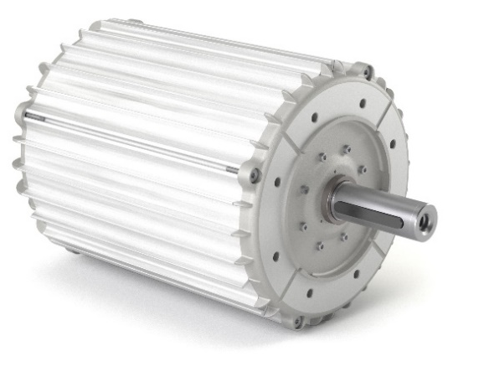
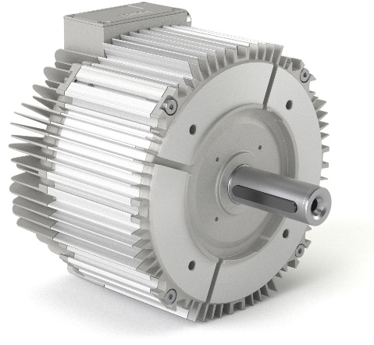
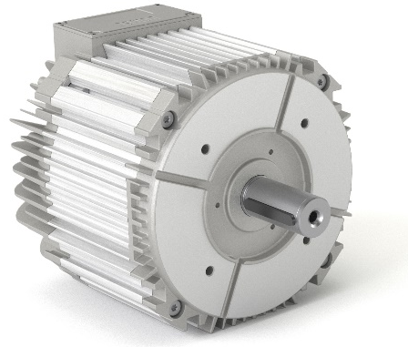
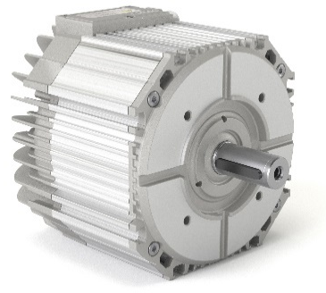
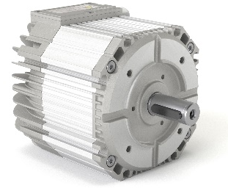
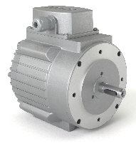
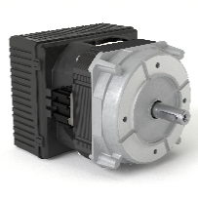
HVAC High efficiency rare earth materials free (ferrite)motor
HIGH -Torque Range „NZ/NZA“
30 - 160 Nm
MID -Torque Range „AZ/ZZ“
2 – 66 Nm
LOW -Torque Range „NS“
1 – 1,8 Nm
(possibility of integrated controller)

Slide 51
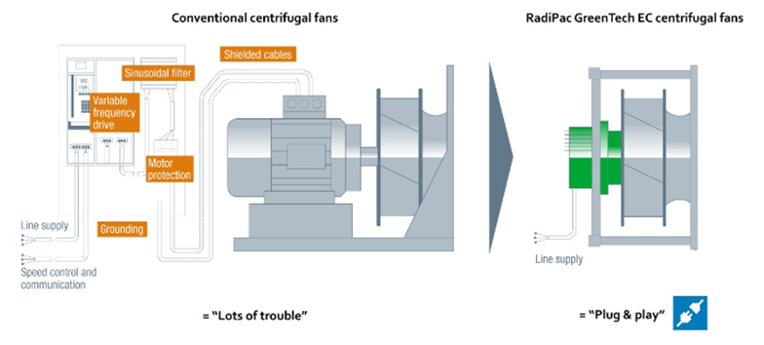
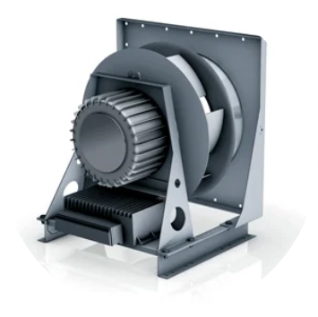
HVAC High efficiency rare earth materials free motor
Domel advantage:
-longer life time
-efficency
- shorter then other shaft motors
Green way compare to conventional

Slide 52


